Slide 1



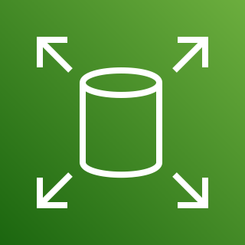



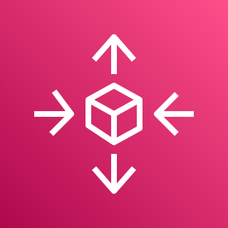

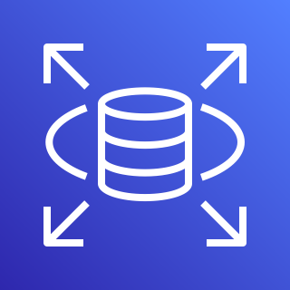


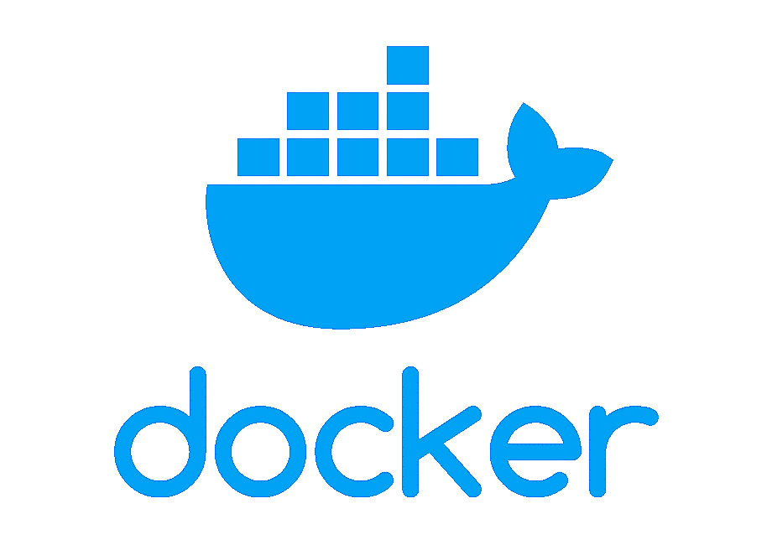






devlopers
S3 storage for all type of data
EBS volume
vpc
Load balancer
Auto Scaling
EC2 instance
Amazon RDS for structure data
Dev & stage
cluster
Load balancer
Auto Scaling
EC2 instance
Amazon RDS for structure data
S3 storage for all type of data
EBS volume
CI from Jenkins to build docker image and push to dockerhub
Image stored
CD from Jenkins and helm to deploy applications
Amazon Elastic Container Registry (Amazon ECR)
Prod cluster
Load balancer
Auto Scaling
EC2 instance
Amazon RDS for structure data
game.solankiempire.site
HELM charts taking from git to deploy application to EKS
S3 storage for all type of data
CloudFront
General user
Load balancer
Prometheus
Grafana
SonarQube
Shared cluster

Slide 2
S3 storage for all type of data
EBS volume
vpc
Load balancer
Auto Scaling
EC2 instance
Amazon RDS for structure data
Dev & stage
cluster
Load balancer
Auto Scaling
EC2 instance
Amazon RDS for structure data
S3 storage for all type of data
EBS volume
Amazon Elastic Container Registry (Amazon ECR)
Prod cluster
Load balancer
Auto Scaling
EC2 instance
Amazon RDS for structure data
game.solankiempire.site
S3 storage for all type of data
CloudFront
General user
Load balancer
Prometheus
Grafana
SonarQube
Shared cluster

